Slide 1
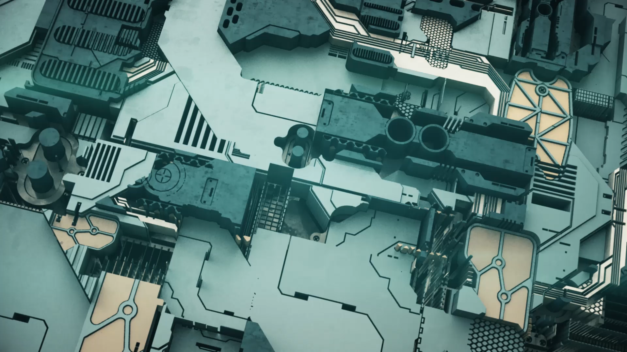
Robot Design and Mechatronics
By Bohdan Skulimoskyi, Bartosz Bester and Zakariyya Mansuri

Slide 2
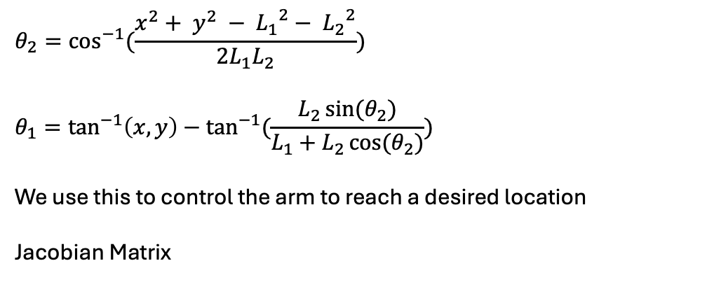
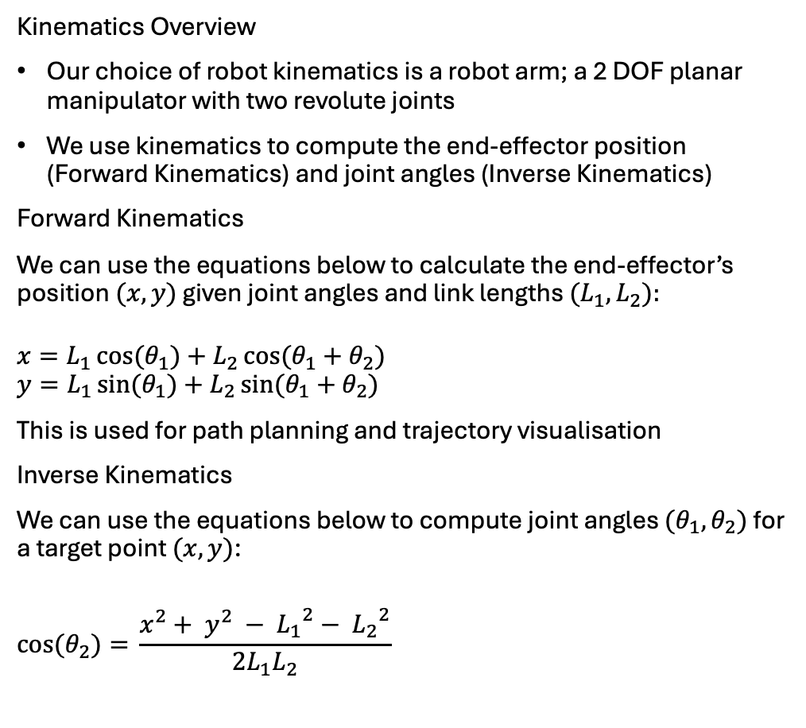
Kinematics
Kinematics Overview
Our choice of robot kinematics is a robot arm; a 2 DOF planar manipulator with two revolute joints
We use kinematics to compute the end-effector position (Forward Kinematics) and joint angles (Inverse Kinematics)
Forward Kinematics
We can use the equations below to calculate the end-effector’s position $(x, y)$ given joint angles and link lengths ${(L}_{1},L_{2}):$
$$x=L_{1}\cos{{(θ}_{1})}+L_{2}\cos{{(θ}_{1} + θ_{2})}$$
$$y=L_{1}\sin{{(θ}_{1})}+L_{2}\sin{{(θ}_{1} + θ_{2})}$$
This is used for path planning and trajectory visualisation
Inverse Kinematics
We can use the equations below to compute joint angles ${(θ}_{1},θ_{2})$ for a target point $(x, y)$:
$$\cos{{(θ}_{2})= }\frac{x^{2}+ y^{2} − {L_{1}}^{2}− {L_{2}}^{2}}{2L_{1}L_{2}}$$
$$θ_{2}=\cos^{−1}{(\frac{x^{2}+ y^{2} − {L_{1}}^{2}− {L_{2}}^{2}}{2L_{1}L_{2}})}$$
$$θ_{1}=\tan^{−1}\left(x, y\right)−\tan^{−1}(\frac{L_{2}\sin{(θ_{2})}}{L_{1}+L_{2}\cos{{(θ}_{2})}})$$
We use this to control the arm to reach a desired location
Jacobian Matrix

Slide 3
Design Sketches

Slide 4
Hardware Components

Slide 5
CAD Implementation

Slide 6
Control (PID)

Slide 7
Simulink Implementation

Slide 8
Testing Controller

Slide 9
Challenges

Slide 10
Potential Improvements

Slide 11
Application Ideas

